Slide 1
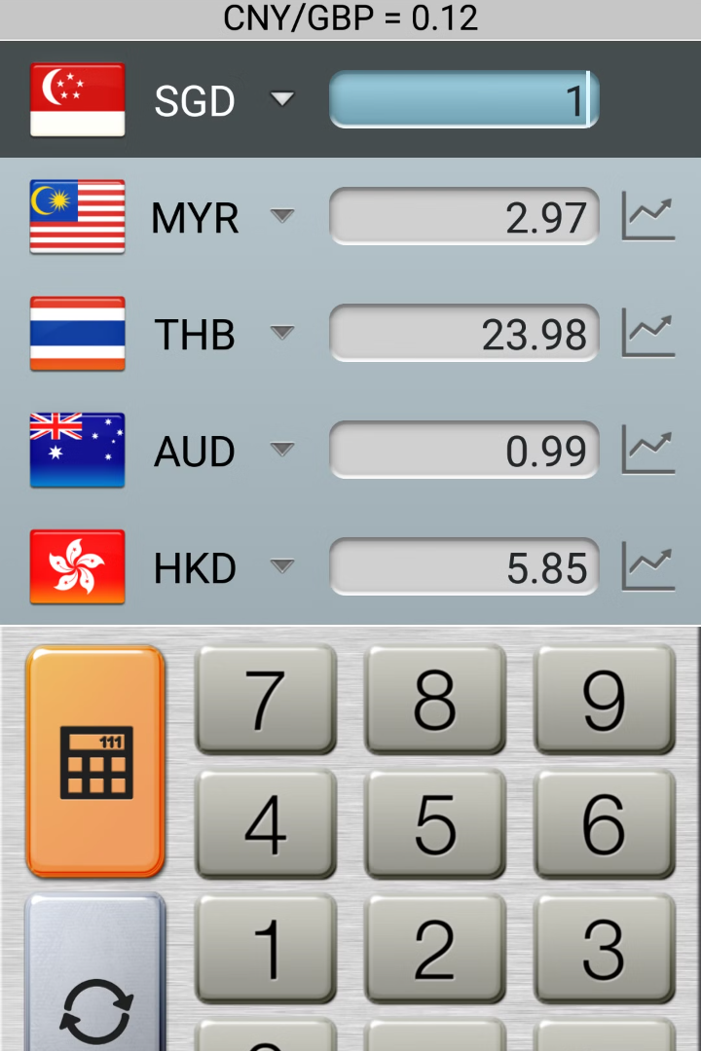

Introduction to Currency Converter
A currency converter is a tool used to convert the value of one currency into another. It is helpful for travelers, investors, and businesses engaging in international trade.
S.MANOJ PRABHU
192121136

Slide 2

How Currency Converters Work
1
Exchange Rate Calculation
Currency converters use current exchange rates to calculate the value of one currency in terms of another.
2
Real-Time Updates
They provide real-time updates to ensure the most accurate conversion values at any given moment.
3
User-Friendly Interface
The interface is designed to be intuitive, making it easy for users to input the desired currencies and amounts.

Slide 3


Popular Currency Conversion Tools
Currency Converter Apps
Online Currency Converters
Mobile apps offer convenient and quick currency conversion on the go.
Websites provide easy access to conversion tools with up-to-date rates.

Slide 4
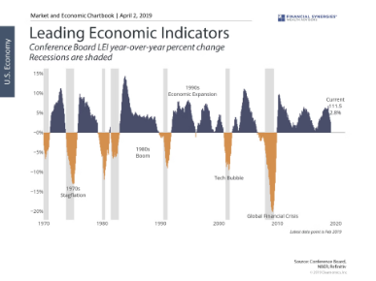
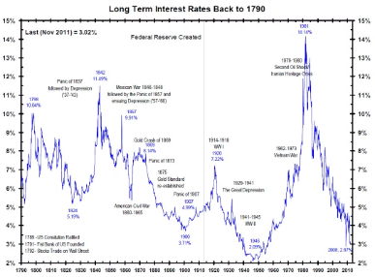
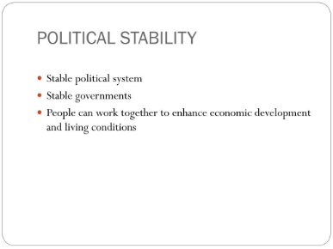
Factors Affecting Exchange Rates
Economic Conditions
Interest Rates
Political Stability
Factors like inflation, government debt, and GDP affect currency values.
Higher interest rates can attract foreign capital, increasing demand for a currency.
Uncertainty or instability in a country can lead to currency devaluation.

Slide 5
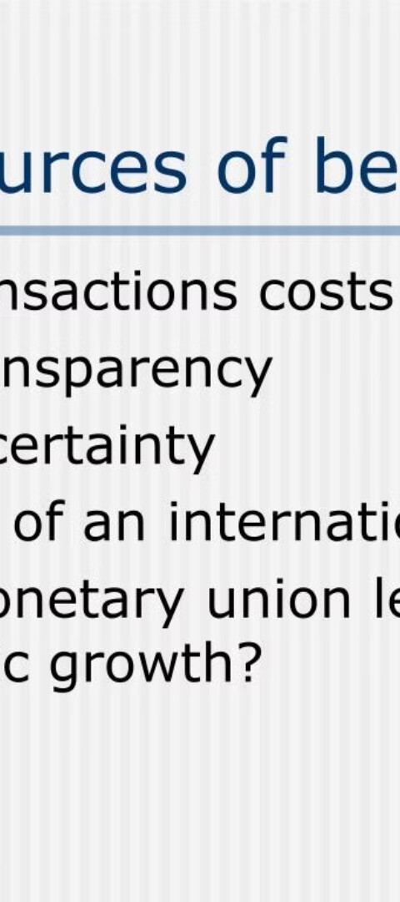
Benefits of Using a Currency Converter
1
Global Transactions
2
Travel Planning
Enables smooth transactions in international trade and commerce.
Helps travelers budget and manage expenses while visiting other countries.
3
Investment Decisions
Assists investors in analyzing the potential risks and returns of international investments.

Slide 6

Risks and Limitations
Exchange Fees
Volatility
Currency converters may apply fees or offer less favorable exchange rates.
Currency values can fluctuate rapidly due to economic or geopolitical events.
Accuracy Concerns
Errors in exchange rates can lead to financial losses, especially in large transactions.

Slide 7




Tips for Using Currency Converters Effectively
Compare Rates
Check rates across different currency converters for the best deals.
Avoid Hidden Fees
Be mindful of extra charges, especially when converting large sums.
Stay Informed
Keep track of global economic news to anticipate currency fluctuations.

Slide 8
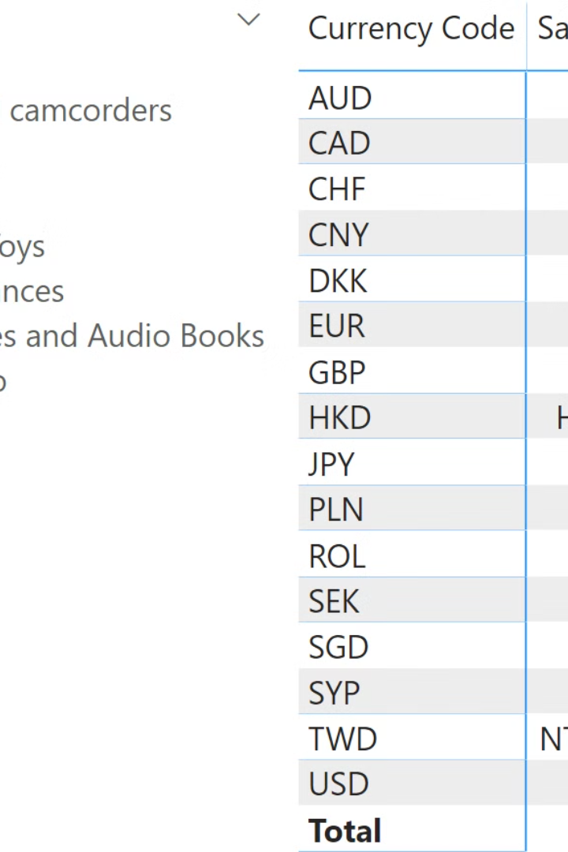
Conclusion and Key Takeaways
Understanding currency converters is essential for anyone engaging in international financial activities. By knowing how they work, their benefits, risks, and effective usage, individuals and businesses can make informed decisions when dealing with different currencies.

